Slide 1
Functional dependencies and Normalization LECTURER: Olivier Kevin ISHIMWE Email: kishimwe@uok.ac.rw tel 0788719655

Slide 2
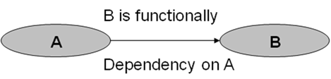
Functional dependencies
An important concept associated with normalization is functional dependency, which describes the relationship between attributes (Maier, 1983). When a functional dependency exists, the attribute or group of attributes on the left-hand side of the arrow is called the determinant.
For example, in the following Figure, A is the determinant of B. we demonstrate the identification of a functional dependency in the following example.
A functional dependency diagram

Slide 3
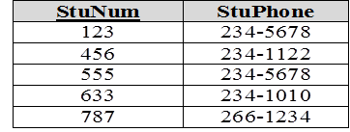
We say an attribute, B, has a functional dependency on another attribute, A, if for a given value of A, there is at most one value for B. We illustrate this as: A → B. For example, suppose we are keeping track of student phone numbers. Suppose each student is identified by his unique student number. Since for a given student number value there is at most one phone number, we say there is a functional dependency of phone number on student number: StuNum → StuPhone. The meaning of this can also be restated as: StuNum functionally determines StuPhone, or, StuNum is a determinant of StuPhone.
Consider the relation and sample data shown in the table below. There is only one row for each student number, and so for each student number there is only one phone number. The data supports the functional dependency StuNum → StuPhone. StudentPhone relation {supports the FD StuNum → StuPhone}

Slide 4
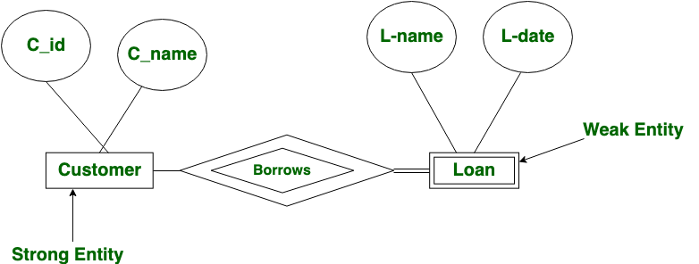
Strong Entity: A strong entity is not dependent of any other entity in the schema. A strong entity will always have a primary key. Strong entities are represented by a single rectangle. The relationship of two strong entities is represented by a single diamond. Various strong entities, when combined together, create a strong entity set.
Weak Entity: A weak entity is dependent on a strong entity to ensure the its existence. Unlike a strong entity, a weak entity does not have any primary key. It instead has a partial discriminator key. A weak entity is represented by a double rectangle. The relation between one strong and one weak entity is represented by a double diamond.
https://www.geeksforgeeks.org/difference-between-strong-and-weak-entity/?ref=lbp

Slide 5
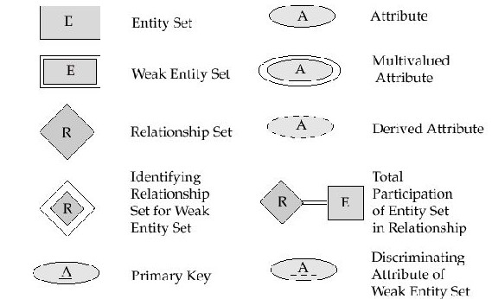
Summary of Symbols Used in E-R Notation

Slide 6
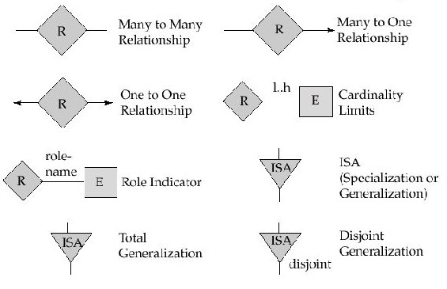
Summary of Symbols (Cont.)

Slide 7
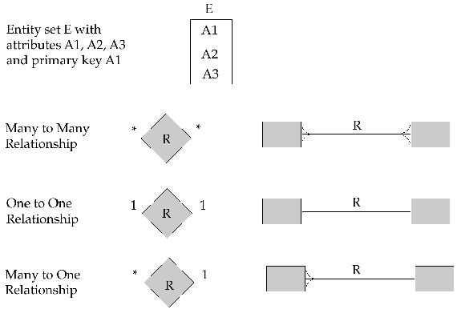
Alternative E-R Notations

Slide 8
TRADITIONAL FILE ORIENTED APPROACH
Earlier the information was maintained in permanent system files. To allow users to manipulate the information, the system has a number of application programs that can manipulate with files. The application programs are written by system programmers in response to the needs of the organization. New programs are added to the system as the need arises. As a result, new permanent files are created. The file processing system is supported by a conventional operating system. Permanent records are stored in various files and different application programs are written to extract records from and to add records to the appropriate files.
Disadvantages of Traditional File Approach
This approach has a number of major disadvantages:
Data redundancy and inconsistency, Difficulty in accessing data due to data isolation, Integrity problems, Concurrent access anomalies and Security problems

Slide 9
Data redundancy and inconsistency
In a file-based system, same information may be duplicated in several files. Redundancy leads to higher storage and access cost. In addition, it may lead to data inconsistency. Data inconsistency means various copies of the same data may not be the same.
Example: An educational institute maintains the details of its students. The registration officer maintains the names of the students, date of joining and course to which they have registered. The accounting officer maintains student’s name, course to which he is admitted, date of joining and fee details (duplication).
This redundancy in storing the data in multiple files has some disadvantages:
Wastage of manual effort to store in multiple files, Wastage of storage area and Problem of updating.

Slide 10
For example, if date of joining is to be updated, in one file it may be updated as 10/10/1998 and in another file it may be updated as 10/1/1998. This causes Data inconsistency.
Difficulty in accessing data due to Data isolation
In a file system, data are scattered in various files and the files may be in different formats. Therefore, it is difficult to write new application programs to retrieve appropriate data in a convenient and efficient manner.

Slide 11
Normalization
Normalization is the process of efficiently organizing data in a database. Besides it is series of steps followed to obtain a database design that allows for efficient access and storage of data in a relational database. Normalization works through a series of stages called normal forms.
These forms avoid duplication of data, ensure that data is stored in the most effective way in the computer and allow for speedier access and retrieval of data. The goal of database normalization is to ensure that every non-key column in every table is directly dependent on the key, the whole key and nothing but the key and with this goal come benefits in the form of reduced redundancies, fewer anomalies, and improved efficiencies

Slide 12
Purpose of normalization
To avoid redundancy by storing each fact within the database only once
To put data into a form that conforms to relational principles (e.g single valued attributes)-no repeating groups
To put data into a form that is more able to accurately accommodate change
To avoid certain update anomalies/instabilities. For example, changing the name of project number P1 from “billing” to “customer-accounting “ may cause this update to be made for all 100 employees working on project “P1”.
The benefits of using a database that has a suitable set of relations is that the database will be easier for the user to access and maintain the data, and take up minimal storage space on the computer

Slide 13
Normalization techniques
First Normal Form
Of all the normal forms, the first is the most important. It provides the foundation on which all other normal forms are built and represents the core characteristics of any table. To be in compliance with the first normal form, a table must meet the following requirements:
Each column in a row must be atomic. In other words, the column can contain only one value for any given row.
Each row in a table must contain the same number of columns. Given that each column can contain only one value, this means that each row must contain the same number of values.
All rows in a table must be different. Although rows might include the same values, each row, when taken as a whole, must be unique in the table.

Slide 14
A relation in which the intersection of each row and column contains one and only one value (atomicity). 1NF ensures that each table has a primary key: minimal set of attributes which can uniquely identify a record. 'First normal form' depends on functional dependency formula f(x)=y. For every value of x there is value for y.
Example of repeating groups

Slide 18
Second Normal Form (2NF)
The second normal form builds on and expands the first normal form. To be in compliance with the second normal form, a table must meet the following requirements:
The table must be in first normal form.
All non primary key columns in the table must be dependent on the entire primary key.
A relation is in 2NF if, and only if, it is in 1NF and every non-key attribute is fully dependent on the primary key. For example, consider a table describing the source of machine parts, with the following attributes:

Slide 21
Third normal form (3NF)
As with the second normal form, the third normal form builds on and expands the previous normal form. To be in compliance with the third normal form, a table must meet the following requirements:
The table must be in second normal form.
All non primary key columns in the table must be dependent on the primary key and must be independent of each other.
A relation is in 3NF if, and only if, it is in 2NF and eliminates functional dependencies on non-key fields by putting them in a separate table. At this stage, all non-key fields are dependent on the key, the whole key and nothing but the key.

Slide 24
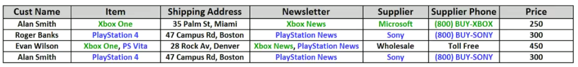
Sales records
1st normal form
Each cell to be single valued
Entries in column are same type
Rows uniquely identified add unique ID, or Add more columns to make unique
(note: the order of the rows and the order of the columns are irrelevant)

Slide 25
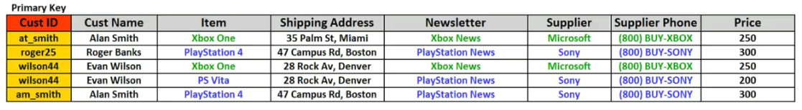
Result of the 1st normal form
Table show the primary keys

Slide 26
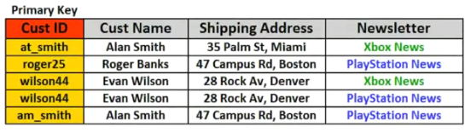
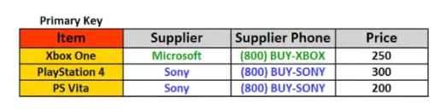
2nd NORMAL FORM All attributes(Non-key columns) depend on the key After being identified the dependent key and attributes

Slide 27
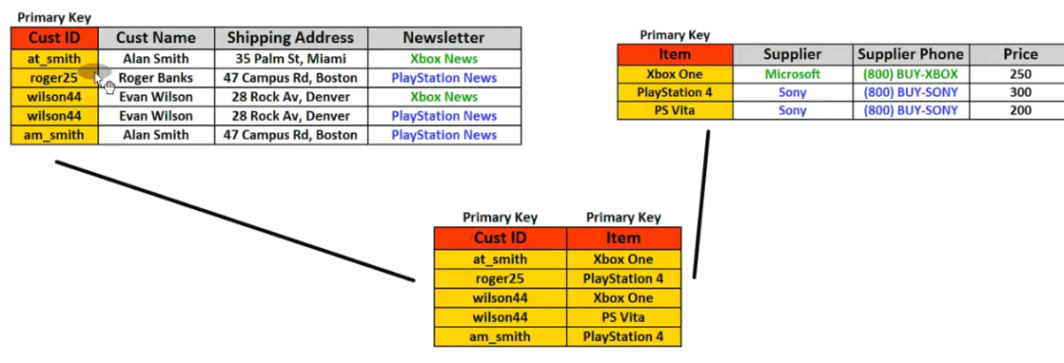
Junction tables and relationship after the 2nd normal form

Slide 28
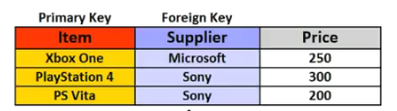
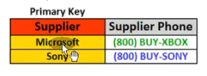
3rd Normal form
All fields(columns) can be determined only by the key in the table and no other columns
Supplier table
On this, the relationship between the tables after the 3rd normal form will show in next side

Slide 29
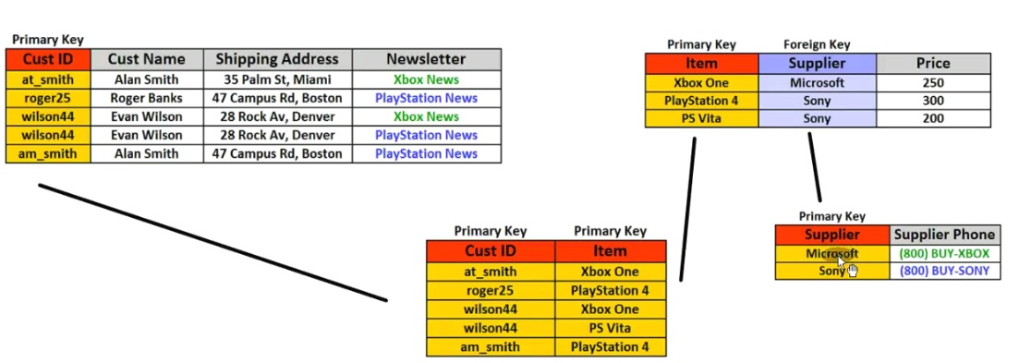
Relationship of the tables after the 3rd normal form

Slide 30
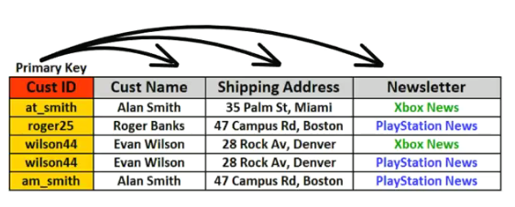
4th Normal Form
No multi-valued dependencies

Slide 31
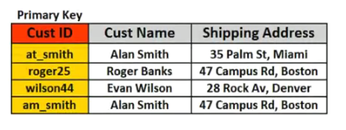
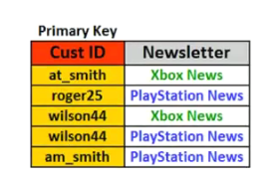
After being separated using the 4th normal form
Cust ID,custname and shipping address will be one table and cust ID and newsletter will be also another table

Slide 32
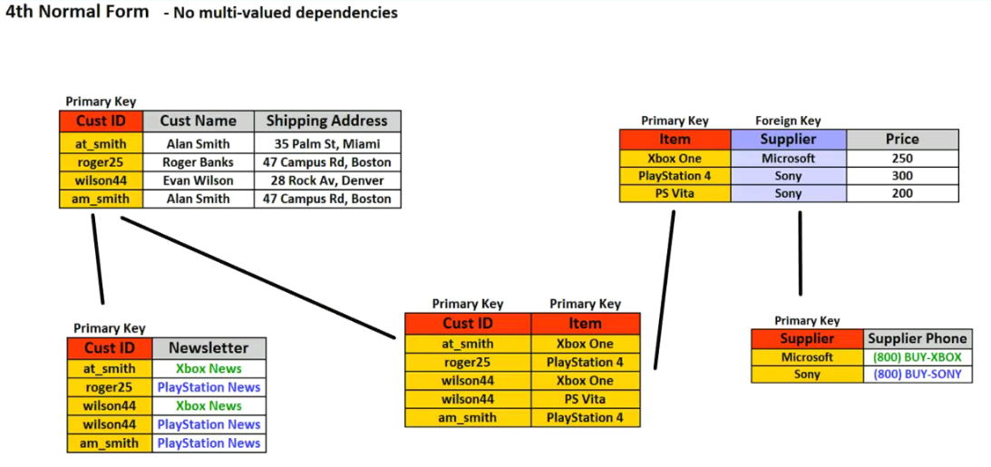
4th normal form after where show no multi-valued dependencies

Slide 33
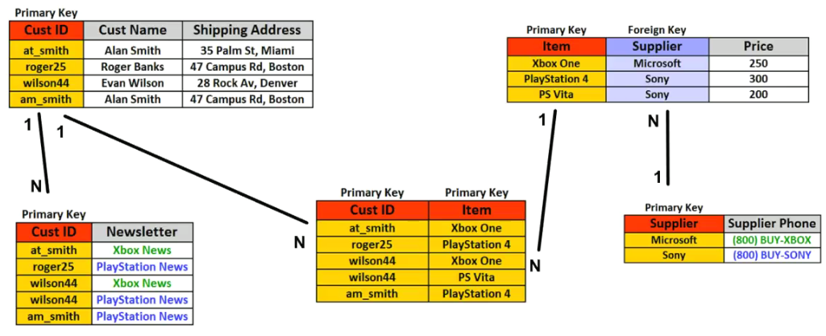
Relationships of the tables after the 4 normal form

Slide 34
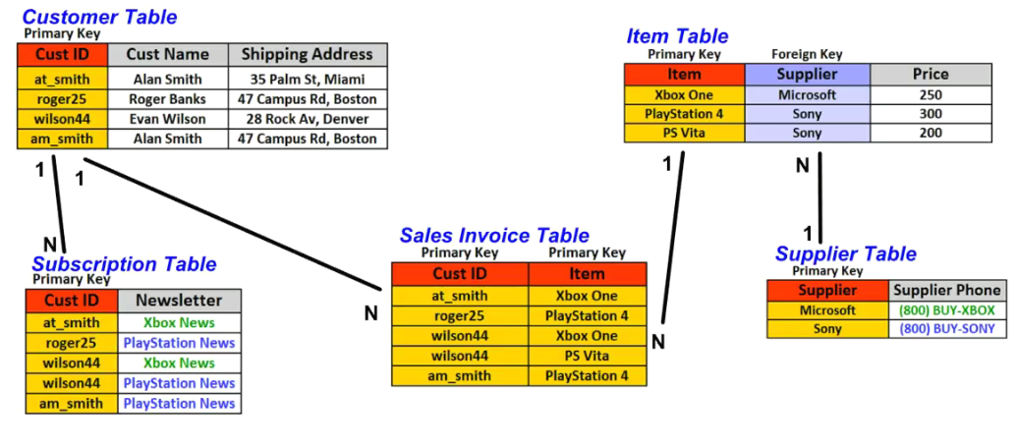
Full normalized database after passing the 4 steps of normalization

Slide 35
DATABASE SYSTEM MODELS AND ARCHITECTURES
2.1 INTRODUCTION
Earlier DBMS software package was one integrated system where large centralized mainframe computers were used. The modern DBMS packages are modular in design, with a client/server architecture where hundreds of distributed workstations and personal computers are connected via communications network. There are various types of servers like Web servers, database servers, file servers, application servers and so on.
A client module will run on a user workstation or personal computer. The client module handles user interaction and provides the user-friendly interfaces such as forms or menu based GUIs.

Slide 36
DATA MODELS, SCHEMAS, AND INSTANCES
2.2.1 Data Model
A data model is a collection of concepts that can be used to describe the structure of the database. It is a type of data abstraction that is used to provide conceptual representation of data. It uses logical concepts that can be easily understood.
A data model is a set of concepts that can be used to describe the structure of a database, which includes data types, relationships and data constraints etc. It also includes a set of basic operations for specifying retrievals and updates on the database.
Categories of Data Models
- High-level or conceptual data model
- Low-level or physical data model
- Representational or implementation data model

Slide 37
i) High level or conceptual data model
This model provides the concepts that are close to user views. The end users can understand them. It uses concepts such as entity, attributes and relationships.
An entity represents a real world object or concept such as an employee or a project that is stored in a database.
An attribute represents some property of interest that further describes an entity, such as employee’s name or salary.
A relationship among two or more entities represents an association among two or more entities, for example, relationship between an employee and a project.
ii) Physical or low-level model
This model provides the concepts that are close to the computer view of storage. They are meant for computer specialists. It describes how data is stored as file in the computer by representing information such as record formats, record orderings and access paths. An access path is a structure that makes the search for particular database records efficient.

Slide 38
iii) Representational model
This model is in between these two extremes of the physical model and the conceptual model. This does not hide all the storage details from the user and it can be implemented on a computer system directly.
It represents data by using record structures and hence is sometimes called Record-based data model.
The current DBMS use representational (implementation) data models widely.
These include the three most popular data models:
- Relational model
- Network model
- Hierarchical model
These data models represent data by using record structure and hence they are also called as record-based data models.

Slide 39
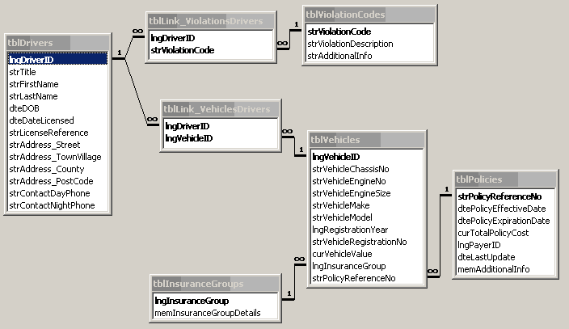
CLASS DIAGRAM

Slide 40
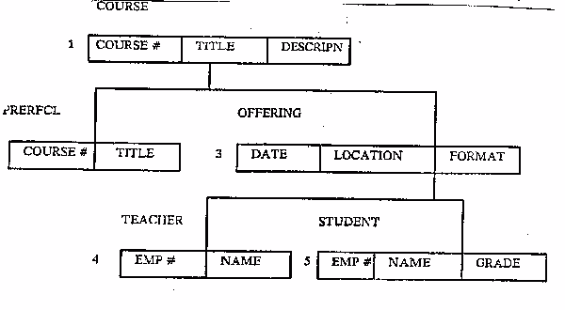
HIERARCHICAL DATA MODEL

Slide 41
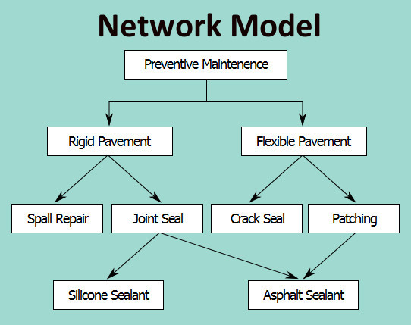

Slide 42
2.2.2 Schemas and Instances, Database State
The database description is called as Database Schema (metadata). The database schema is defined during the database design only and it is not expected to change frequently.
Many of the data models provide the diagrammatic representation of the schema, known as the Schema diagram.
Here, only the database structure is displayed without any actual data. Each object in the schema is called a Schema construct, such as student, course, section, etc

Slide 43

Figure 2.1 Schema Diagram for University Database
But a schema diagram does not represent all the aspects of a database structure. In the above schema diagram, neither the data type of each item is shown nor the relationship among the various files object. Also it does not include the constraints.
In the database, actually the data may change from time to time. For example, if we want to add a new student or change the section of a student, we have to make changes in the database.

Slide 44
2.2.3 Database states (instance)
The data contained by the database at any particular moment in time is called the state of the database or snapshot.
It also known as current set of occurrences or instances in the database.
Each construct of the database will have its own state at any instance of time. If changes are made in the database, it changes the state of the database into another state.
An instance is a collection of memory structures and processes while a database are files on disk.
When a new database is defined, its database schema is specified only to the DBMS. At this point of time, the database is in Empty State with no data.
When the database is first loaded with initial data, it is said to be in the Initial State.
Every time an update operation is performed on the database, it enters another database state. The state of the database at any instance of time is called the Current State.

Slide 45
2.3 DBMS ARCHITECTURE
DBMS architecture consists of three levels known as Three Schema Architecture. It is a convenient tool with which the user can visualize the schema levels in a database system.
It contains the following three schemas:
The Internal Level: This consists of an internal schema, which describes the physical storage structure of the database. It does not hide the storage details.
The Conceptual Level: This has a conceptual schema, which describes the structures of a database for a group of users. This schema hides the storage details from the user and it includes description of entities, data types, relationships, user operations and constraints.
The External Level: This has a number of external schemas or user views. Each external schema describes the part of the database that a particular user group is interested in and hides all the other details from this group (all other databases).

Slide 46
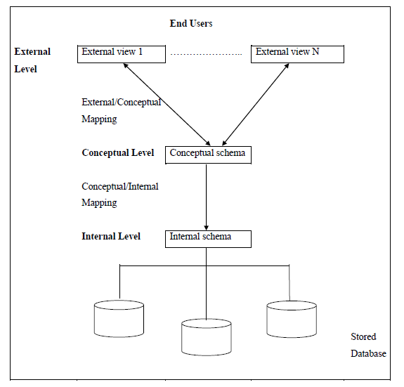
Figure 2.2 Three-schema DBMS architecture
The three schemas are only description of the data but the actual data exists only at physical level. In a three-level architecture based DBMS; the user refers to its own external schema only. Then the DBMS must transform the request specified by the external schema into a request against the conceptual schema and then into a request on the internal schema for processing over the stored database. If the request is to retrieve a database, it has to be reformatted to meet the user requirements. This process of transforming requests and results between the three levels of schemas is known as Mapping.

Slide 47
MAPPING
The transformation of requests and results between the three levels are called Mappings.
As shown in the figure, two mappings are required for a three-level DBMS. The two types of mapping are:
- External/Conceptual Mapping
- Conceptual/Internal Mapping
External/Conceptual Mapping
The mapping between external and conceptual level, gives the correspondence between records and relationships of external and conceptual levels.
Conceptual/Internal Mapping
The mapping between conceptual and internal levels gives the correspondence between the structure (metadata) and the size and position of the data in the stored database.
So the three level schema architecture is a convenient tool with which the user can visualize the schema levels in a database system.

Slide 48
2.4 DATA BASE SYSTEM ARCHITECTURES
Database system architecture consists of 3 types:
Centralized architecture, Distributed architecture and client/server architecture .
2.4.1 CENTRALIZED ARCHITECTURE
With the use of personal computers and workstations, the database systems were centralized in which all the DBMS functionality, application program execution and user interface processing were carried out on one machine.
In a centralized database system, always the data and the DBMS software reside only at one place or site. Other sites, which are connected to this centralized site can access the database.
In a centralized system if the central system fails, then the entire system will be halted.

Slide 49
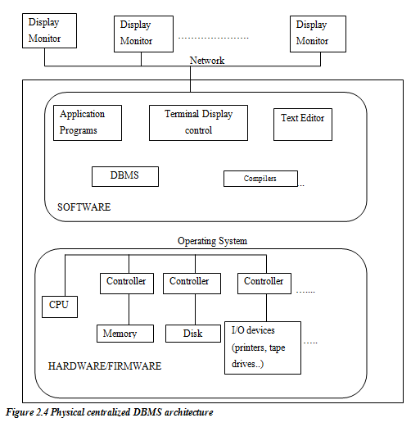

Slide 50
2.4.2 DISTRIBUTED ARCHITECTURE
As the complexity of the database increases, it becomes difficult to handle the database entirely at one place.
The solution for this is to distribute the database into different sites, which are interconnected through some communication network.
Advantages of Distributed DBMS
Naturally distributed data, Reliability and availability
Controlled data sharing, Improved performance
- Naturally distributed data
In some cases data is naturally distributed over different areas. For example, a company may have its head quarters in one place and its branches may be situated in some other places. In such cases, the different sites maintain only their local data, coming under their limitations. Only the global users, such as the head quarters will refer to these local sites, whenever need arises.

Slide 51
- Reliability and Availability
In a distributed system, because the data is distributed over different sites, even if one site fails, the system will continue working with other sites. Only the data under the failed site will not be accessible. Thus Distributed DBMS are more reliable, compared to centralized systems. Also, since each site handles only limited amount of local data, the system is relatively less busy. This increases the probability of the system being available continuously at any given time interval. Duplicating the data and the software at different sites also improves the performance.
- Controlled data sharing
Since each site controls its data and the software, it is called localized control. Occasionally, some other sites may access or share the data of another site, through the software. Hence, controlled sharing of data is achieved.

Slide 52
- Improved performance
In Distributed DBMS a large database is divided into smaller databases at different sites. Hence, the size of the databases at different sites is limited, and because of this limited size, the complexity is reduced at every stage, thereby improving the performance. As a result, minimum transactions will be there and data will be accessed faster. If data is shared from different sites, processing may proceed in parallel at different sites.
Distributed DBMS must have some additional functions:
- Ability to access remote sites through the network
- Keeping track of data distribution and replication in the DBMS catalog
- Defining strategies for queries, which share the data from different sites.
- Ability to maintain the consistency of replicated data at different sites.

Slide 53
2.4.3 CLIENT-SERVER ARCHITECTURE
The client/server architecture was developed to deal with computing environments in which a large number of PCs, workstations, file servers, printers, database servers, web servers and other requirement are connected via a network.
In client server architecture, number of personal computers, workstations, servers and printers are involved. Each server is assigned a specific functionality.
For example, software server stores the software required by all its clients, whereas the client machine can only store the programs and for executing these programs, they should get connected to the server. Similarly we have file server that maintains the files of the client machines. We have the printer server which is connected to various printers and all print requests by the clients are forwarded to this machine. The resources provided by specialized servers can be accessed by many client machines. The client machines provide the user with the appropriate interfaces to utilize these servers, as well as with local processing power to run local applications.

Slide 54
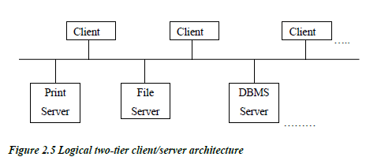
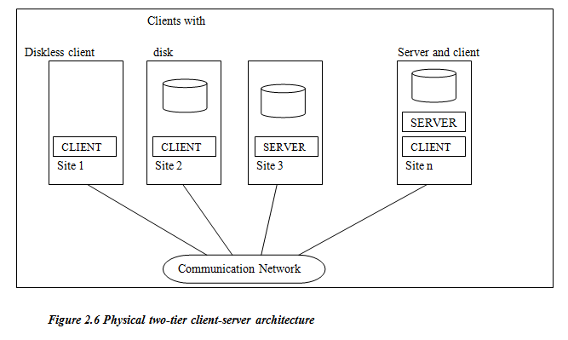
TWO-TIER CLIENT/SERVER BASED ARCHITECTURE
In two tier architecture, the software components are distributed over two systems: the client and the server.

Slide 55
A client is a user machine that provides user interface capabilities and local processing. When a client requires access to additional functionality that does not exit at that machine, it connects to a server that provides the needed functionality.
A server is a machine that can provide services to the client machines such as file access, printing, archiving, or database access.
Some machines install only server software, some install only client software, other
Advantages of two tier architecture
Simplicity
Compatibility with existing systems
s include both client and server software.

Slide 56
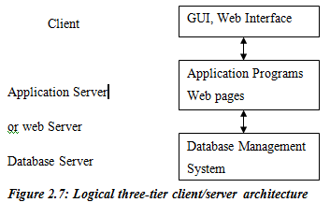
THREE-TIER CLIENT/SERVER ARCHITECURE
With the emergence of World Wide Web, many web applications use the three-tier architecture. There is an intermediate layer between the client and the database server called the application server or web server and is named according to the application.

Slide 57
The web server plays the intermediary role by storing business rules (procedures or constraints) that are used to access data from the database server. It checks the client’s credentials before forwarding a request to the database server. The intermediate server accepts requests from the client, processes the request and sends database commands to the database server, and then acts as a conduit for passing processed data from the database server to the clients, where it may be processed further and filtered to be presented to users in GUI format.
The user interface, application rules and data access acts as the three tiers.
2.5. Type and Use of the Database Interface
Following, two important uses of a database interface like SQL are listed:
Interactive: SQL can be used interactively from a terminal.
Embedded: SQL can be embedded into another language (host language) which might be used to create a database application.

Slide 58
2.6 CLASSIFICATION OF DBMS
DBMS may be classified in various ways.
Based on data models
Based on number of users that are supported by the system
Based on number of sites that the database is distributed
Based on the purpose
Based on the data models
DBMS may be classified as
- Relational model
- Network model
- Hierarchical model
- Object-oriented model
- Object-relational model

Slide 59
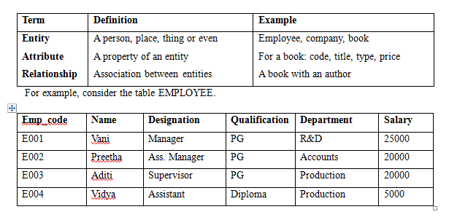
RELATIONAL MODEL
The Relational Data model represents a database as a collection of tables, where each table can be stored as a separate file. Most relational databases have high-level query languages and support a limited form of user views.
A relational database allows the definition of data structures, storage and retrieval operations and integrity constraints. In such a database, the data and relations between them are organized in tables. A table is a collection of records and each record in a table contains the same fields.

Slide 60
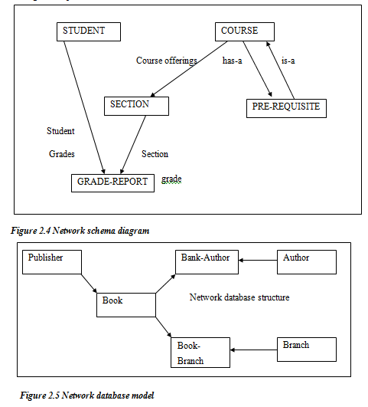
NETWORK MODEL
The Network Data Model represents data in terms of records and also relationship. The network model permitted the modeling of many -to-many relationships in data.

Slide 61
A network database consists of two data sets: “A set records” and “A set links”. The record types are made up of fields in the usual way. Links may be followed in their direction.
Characteristics of Network Model
Data is organized into logical units called record types
Record types can have more than one owner (each data grouping can belong to more than one category)
There are many efficient entry points into the database
HIERARCHICAL MODEL
In a hierarchical data model, data is organized into a tree-like structure. Each hierarchy represents a number of related records. There is a hierarchy of parent and child data segments.
It collects all the instances of a specific record together as a record type. These record types are the equivalent of tables in the relational model, and with the individual records being the equivalent of rows.

Slide 62
Characteristics of Hierarchical Data model
Data is grouped into logical units called segment types.
Segment types are linked in a parent/child hierarchical where each child segment type has only one parent segment type.
There is only one efficient entry point.
Database use physical pointers to link records.
Advantages
1. The structure of a hierarchical database is easy to understand. The hierarchy is based on logical relationships between parent and child segment types.
2. They provide very efficient high speed retrieval.
Disadvantages
There are difficult to modify as an organization’s data needs change.
It is difficult to use them to represent non-hierarchical relationships

Slide 63
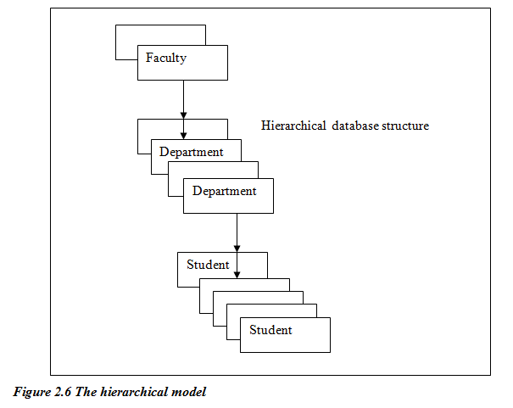
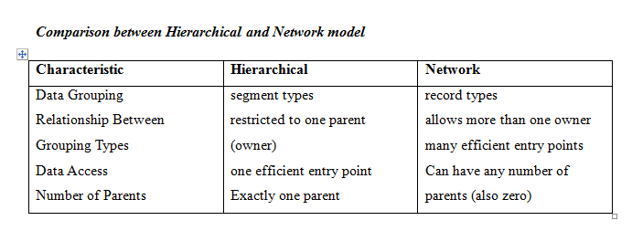
The Figure 2.6 represents a hierarchical database at a typical school where each faculty employs many departments and each department advises many students.

Slide 64
Based on the number of sites on which database is distributed
DBMS can be classified as: Centralized DBMS, Distributed DBMS, Homogeneous DBMS and On-line transaction processing DBMS
Centralized DBMS contains the database at only one computer site, which can support multiple users.
Distributed DBMS contains the database and the DBMS software distributed over number of computer sites, connected by a network.
Homogeneous DBMS is the same DBMS existing in multiple sites. The recent trend is to develop software to access several autonomous pre-existing databases stored under heterogeneous DBMS.
One-line transaction processing (OLTP) Reservation clerks at railways and airlines use special purpose DBMS software that supports a large number of concurrent transactions without imposing excessive delays. This is an example of On-line transaction processing system.

Slide 65
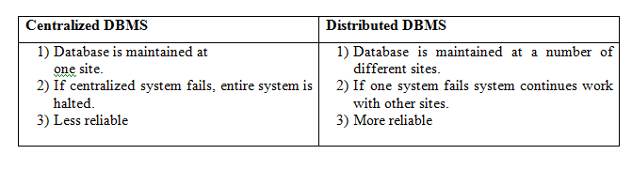
Based on purpose
DBMS could be classified as:
- Special purpose
- General purpose
Special purpose DBMS is a package developed to suit the needs of a particular user, which cannot be used by other users. Reservation clerks at Railways and Airlines use this type of packages. These fall into the category of on line transaction processing systems, which must support a large number of concurrent transactions without imposing excessive delays.

